Slide 1
Low Order through rate in the city of Hyderabad

Slide 2

Business Problem
Why is the order through rate for the e-commerce start-up in Hyderabad
is significantly lower when compared to the national average ?

Slide 3
Root Cause of the problem is that the Zone 3,8 & 10 is offering the least discount in the Hyderabad City.

Slide 4
How we found the root cause of the problem
Describing the 5W’s of the problem and formulating the hypothesis.
Doing Visual Analysis of the data and identifying the key areas of concerns.
Checking out which zones in the city of Hyderabad are not performing well.

Slide 5
5W’s OF THE PROBLEM
Who ? | Here it is the E-Commerce Start-up Company.
What ? | Low order through rate in the city of Hyderabad
When ? | During the time of pandemic(starting from march 2020)
Where ? | The city of Hyderabad
How ? | High delivery time or no discount/offers.

Slide 6
Hypothesis
Company | Collaborators | Customers | Competitors | Context PESTEL
Low product lines to meet the demands of the customers in the city of Hyderabad – P0 | Inefficient supply chain management and delivers faulty products – P0 | The spending power has been reduced due to the pandemic- P0 | They have better supply chain and logistics management - P1 | The buying trends of the customers have changed during the pandemic – P1
User interface is not good – P1 | Delayed delivery time and misplace of orders - P1 | The e-commerce start-up have not identified the basic needs of their customers during the time of pandemic – P1 | Offer better discounts and offers to the customers- P0 | The new lockdown rules may have affected the e-commerce business – P1

Slide 7
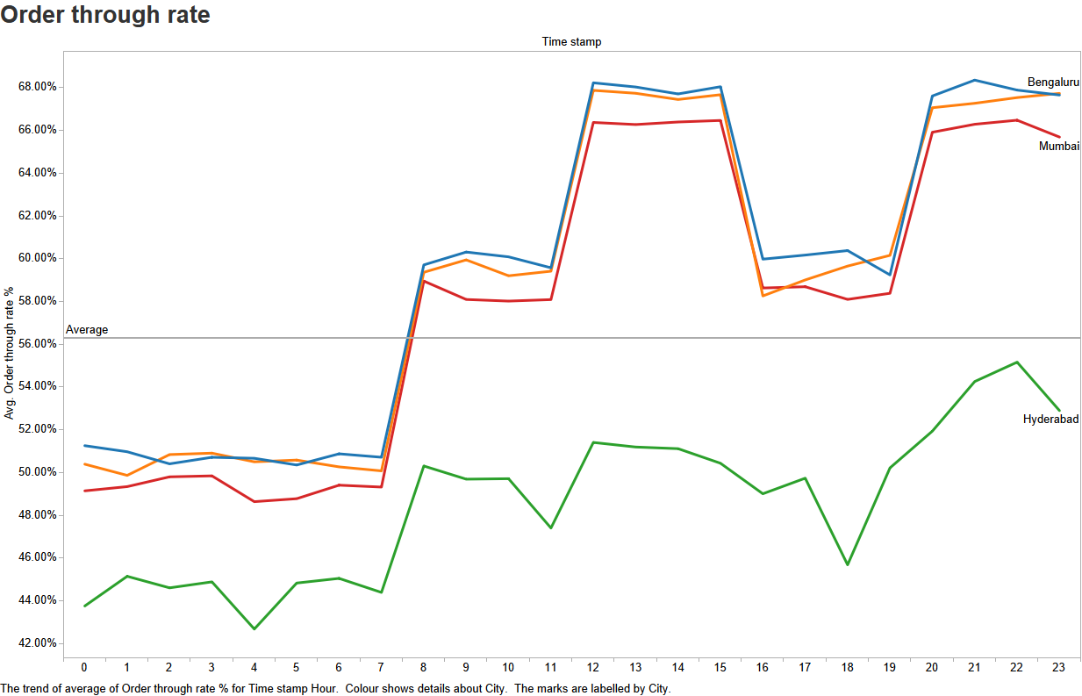
Visual Analysis
Order through rate:-
Product of catalogue to cart and cart to order
Analysis –
Order through rate is low through the entire day
Order through rate is below than the national average

Slide 8
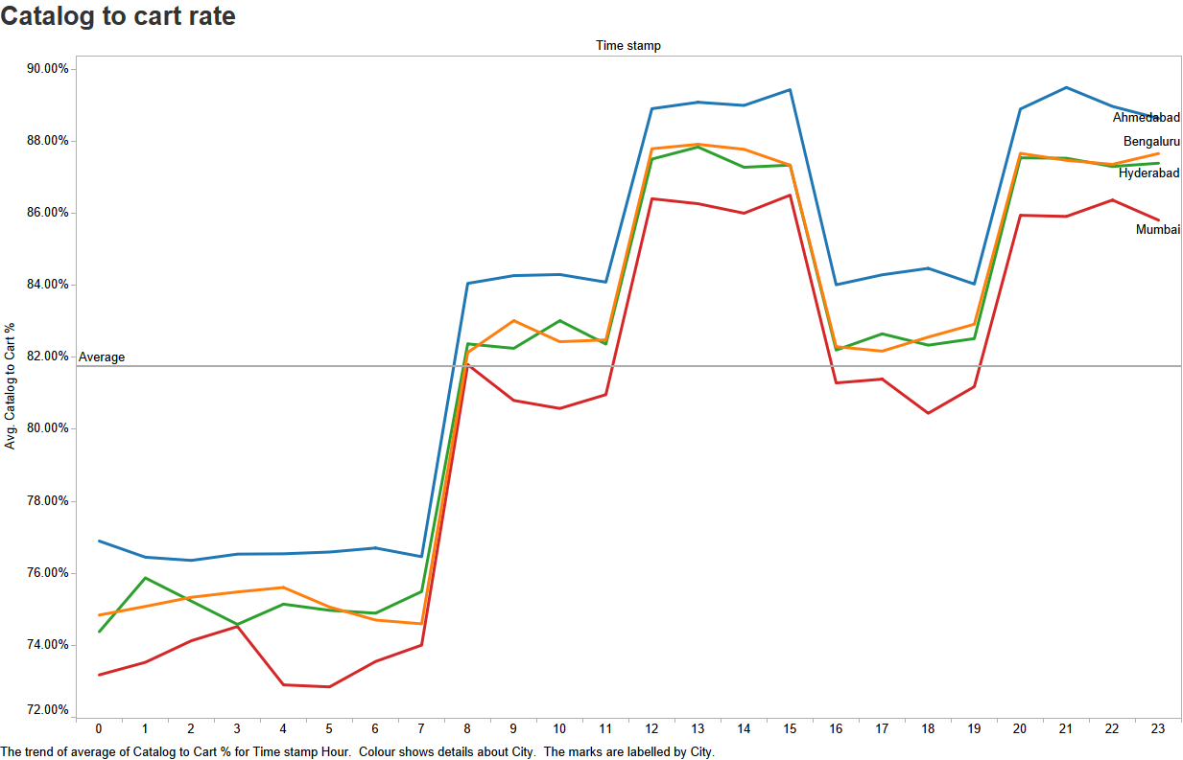
Analysis continued.....
Catalogue to cart rate:-
Out of the customers landed, the %age who placed items in their cart
Analysis –
All the cities are performing well and equal
No concerns in this scenario

Slide 9
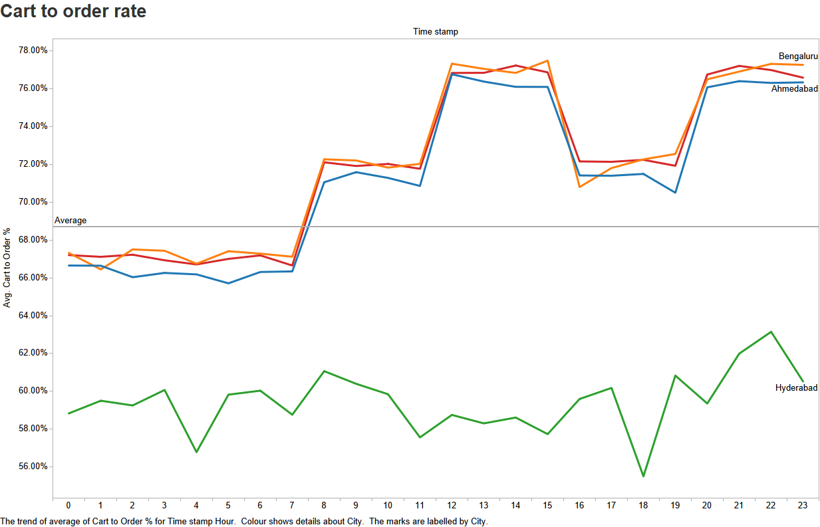
Analysis continued.....
Cart To Order:-
Out of the customers that placed items in the cart, the %age who placed the order
Analysis-
Cart to order rate for Hyderabad is very low as compared to other cities
This shows that the customers order less even after adding items to their cart

Slide 10
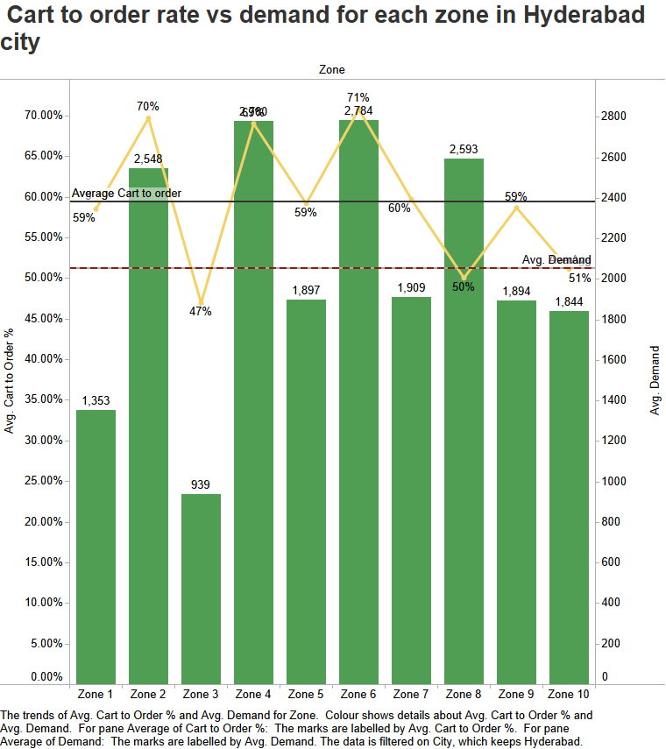
Analysis continued...
Cart to order rate vs demand for each zone in Hyderabad city –
To visualise which zones are underperforming on the basis of demand and cart to order
Analysis –
Zone 1 & Zone 3 are under performing , less than the average demand and average cart to order
Zone 3,8 & 10 have less than the average cart to order rate

Slide 11
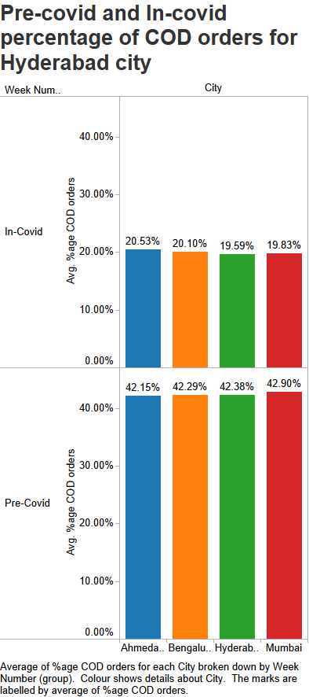
Analysis continued...
Percentage of COD orders –
Out of the orders placed, %age of orders that selected Cash on Delivery as payment option
Analysis –
Hyderabad has less percentage COD orders during the
Covid period.

Slide 12
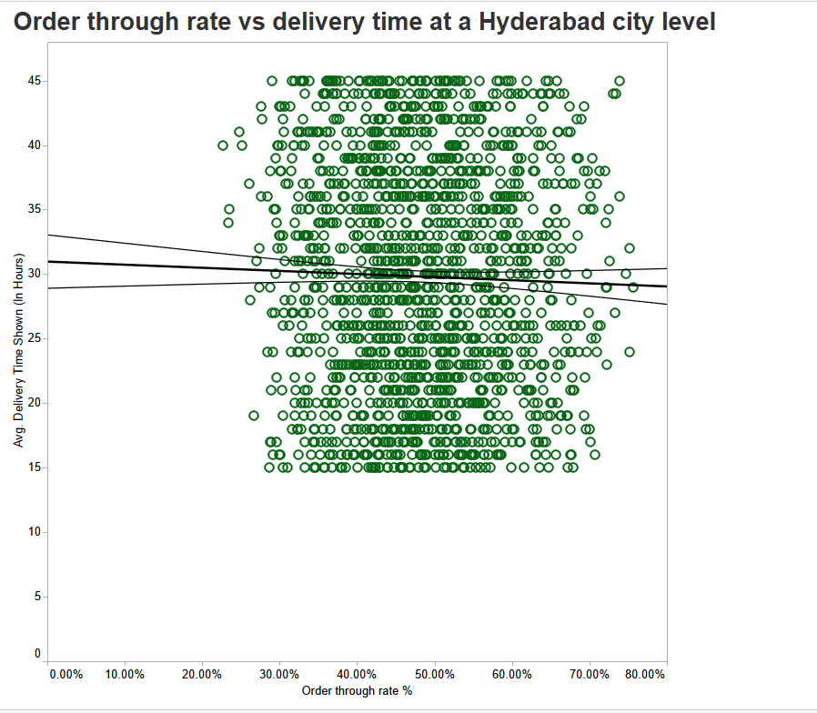
Visual Analysis
The scatter plot depicting order
through rate vs delivery time
has no linearity, this states that the
That the magnitude of correlation
between both the variables is low

Slide 13
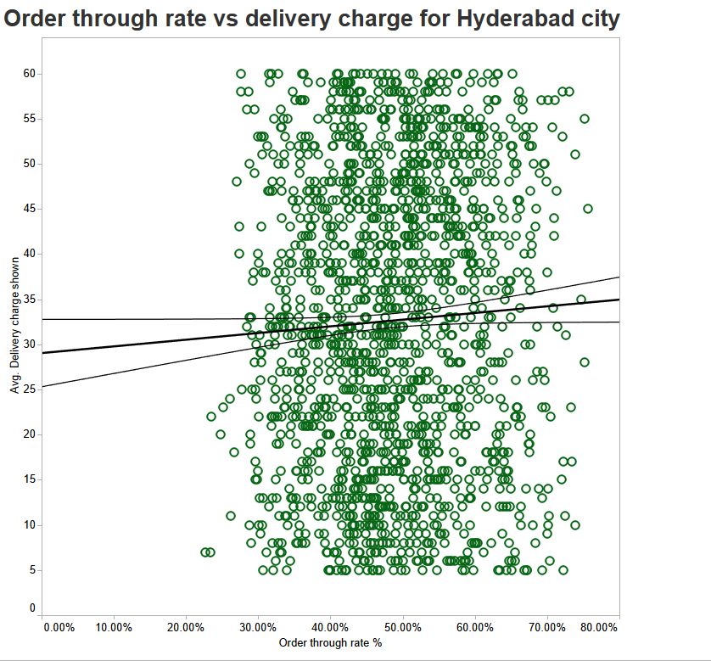
There is no linearity between both the variables,
The order through rate does not get affected
even when the delivery charges are increasing,
They have a weak correlation.

Slide 14
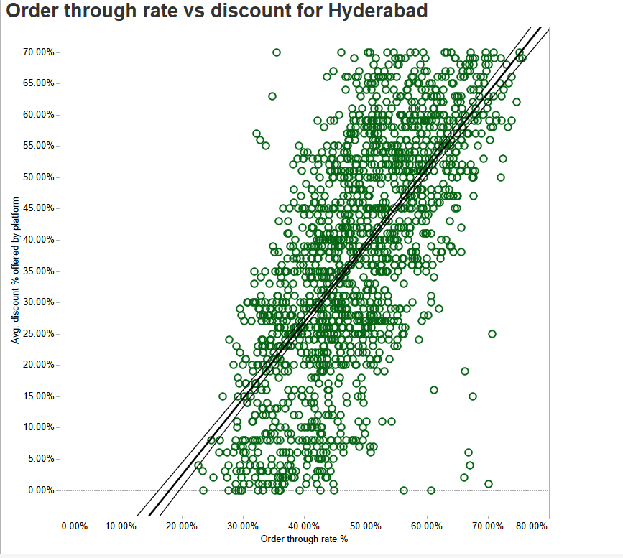
As per this scatter plot we can see that
Both the variables are strongly correlated
to each other, the order through rate
Increases when the discount increases
Conclusion: from all the 3 scatter plot we can conclude that the Order through rate vs
Discount has the strongest correlation

Slide 15
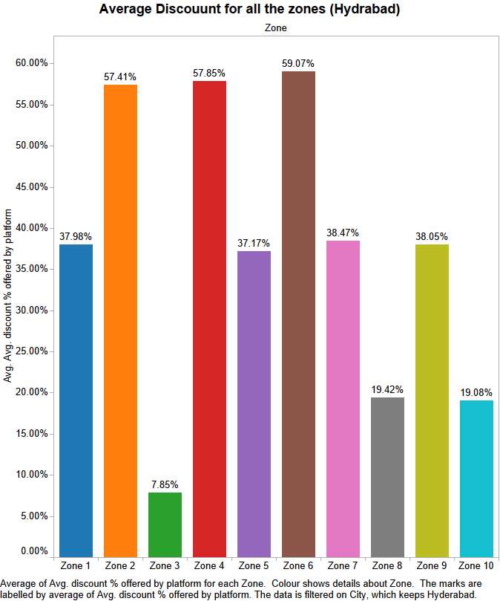
Root Cause of the problem - Average Discounts offered
Zone 3,8 & 10 offer the least discount due to which the Order
Through Rate is low in the city of Hyderabad

Slide 16
Conclusions
Hyderabad has low cart to order rate in comparison to other cities
Zone 3,8 & 10 offer the lowest discounts in the city of Hyderabad
Zone 1 & 3 have the least demand in the city of Hyderabad( less than the city average)
Zone 3,8 & 10 have low cart to order rate(less than the city average)

Slide 17
Recommendations
Use high quality images and videos on the product images
Offer free shipping or provide limited coupon codes
Be competitively priced
Tweak ad test your ecommerce website checkout process and provide a better user interface
Use live chat software
Provide more discount and promo offers for the problematic areas (Zone 3,8 & 10)

Slide 18
Thank You

